Slide 1

Week 1: Course Overview & Introduction/ Motivation for Structured Decision Making
Instructor: Brielle K Thompson
Course: NAT_R 8001 Decision Analysis for Research and Management of Natural Resources
Notes:
First 30 minutes = intro
Next 60 = slides
Final 30 = activity

Slide 2
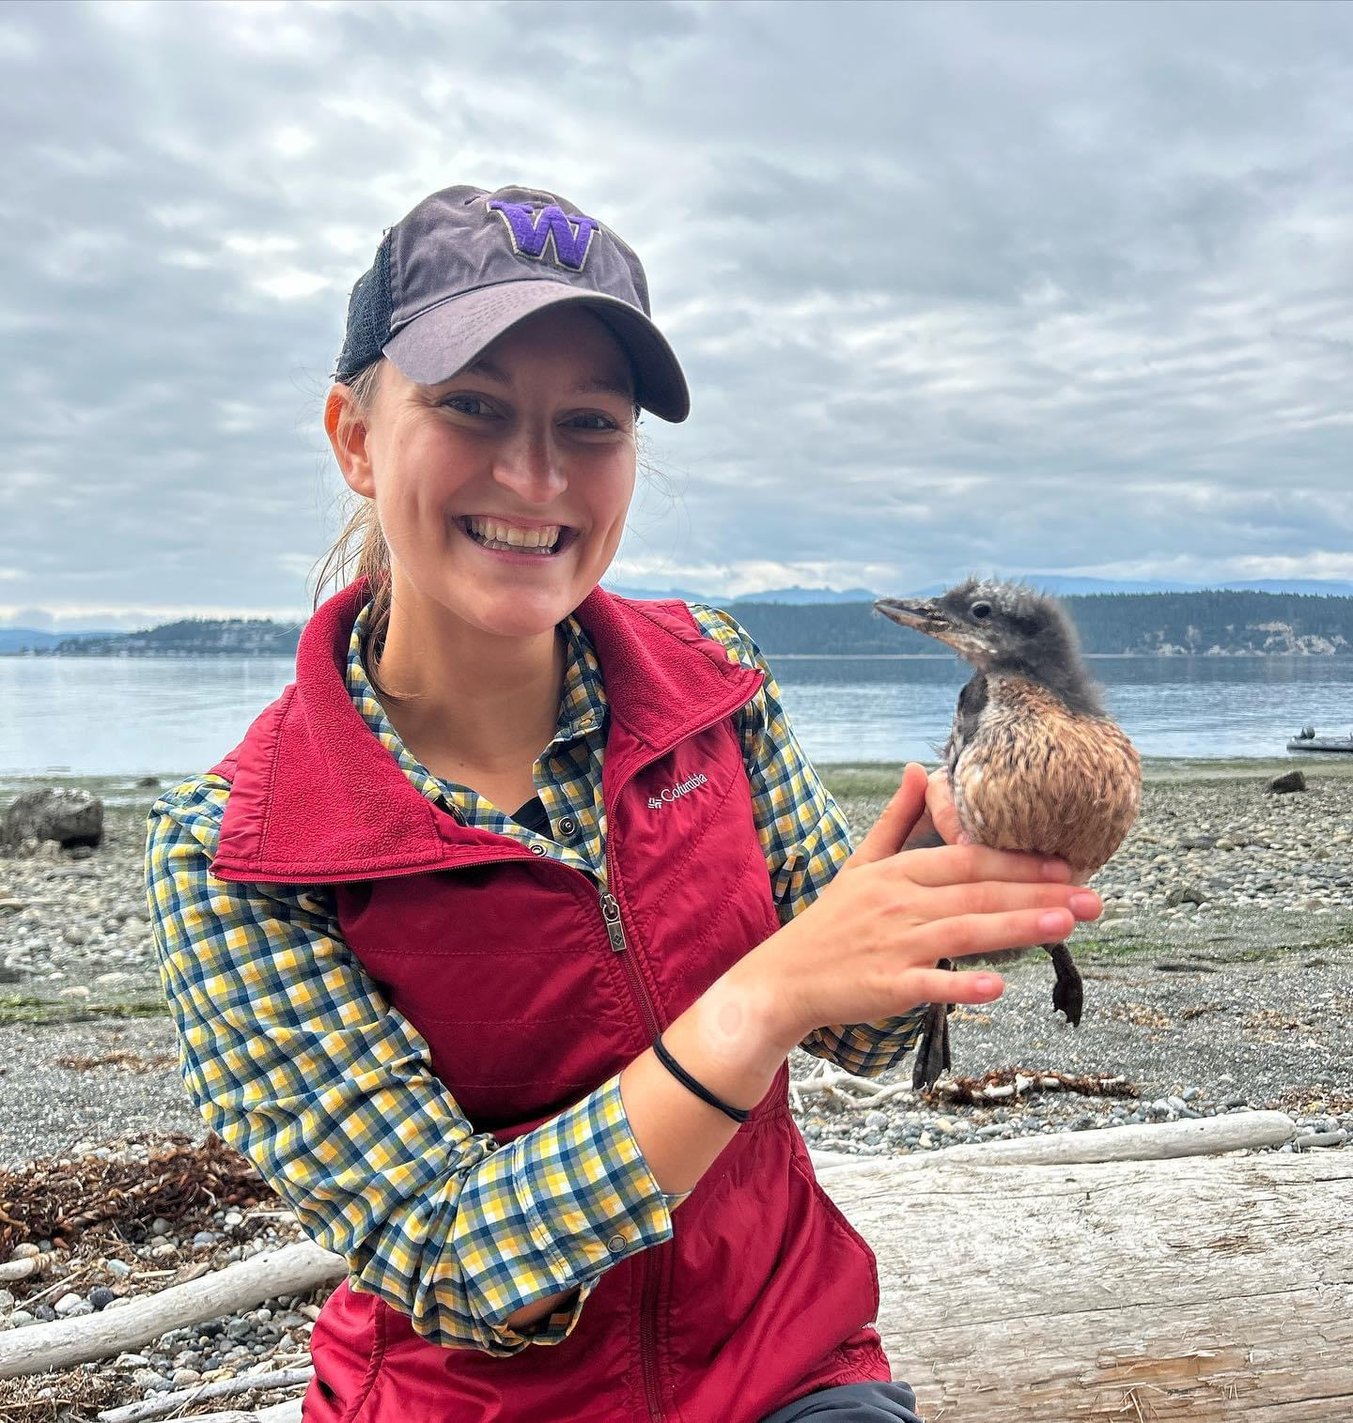
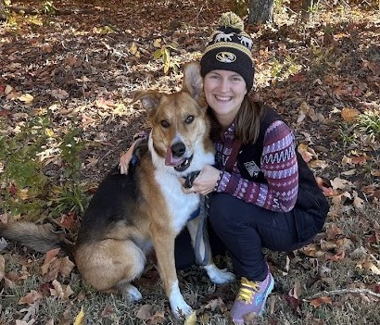
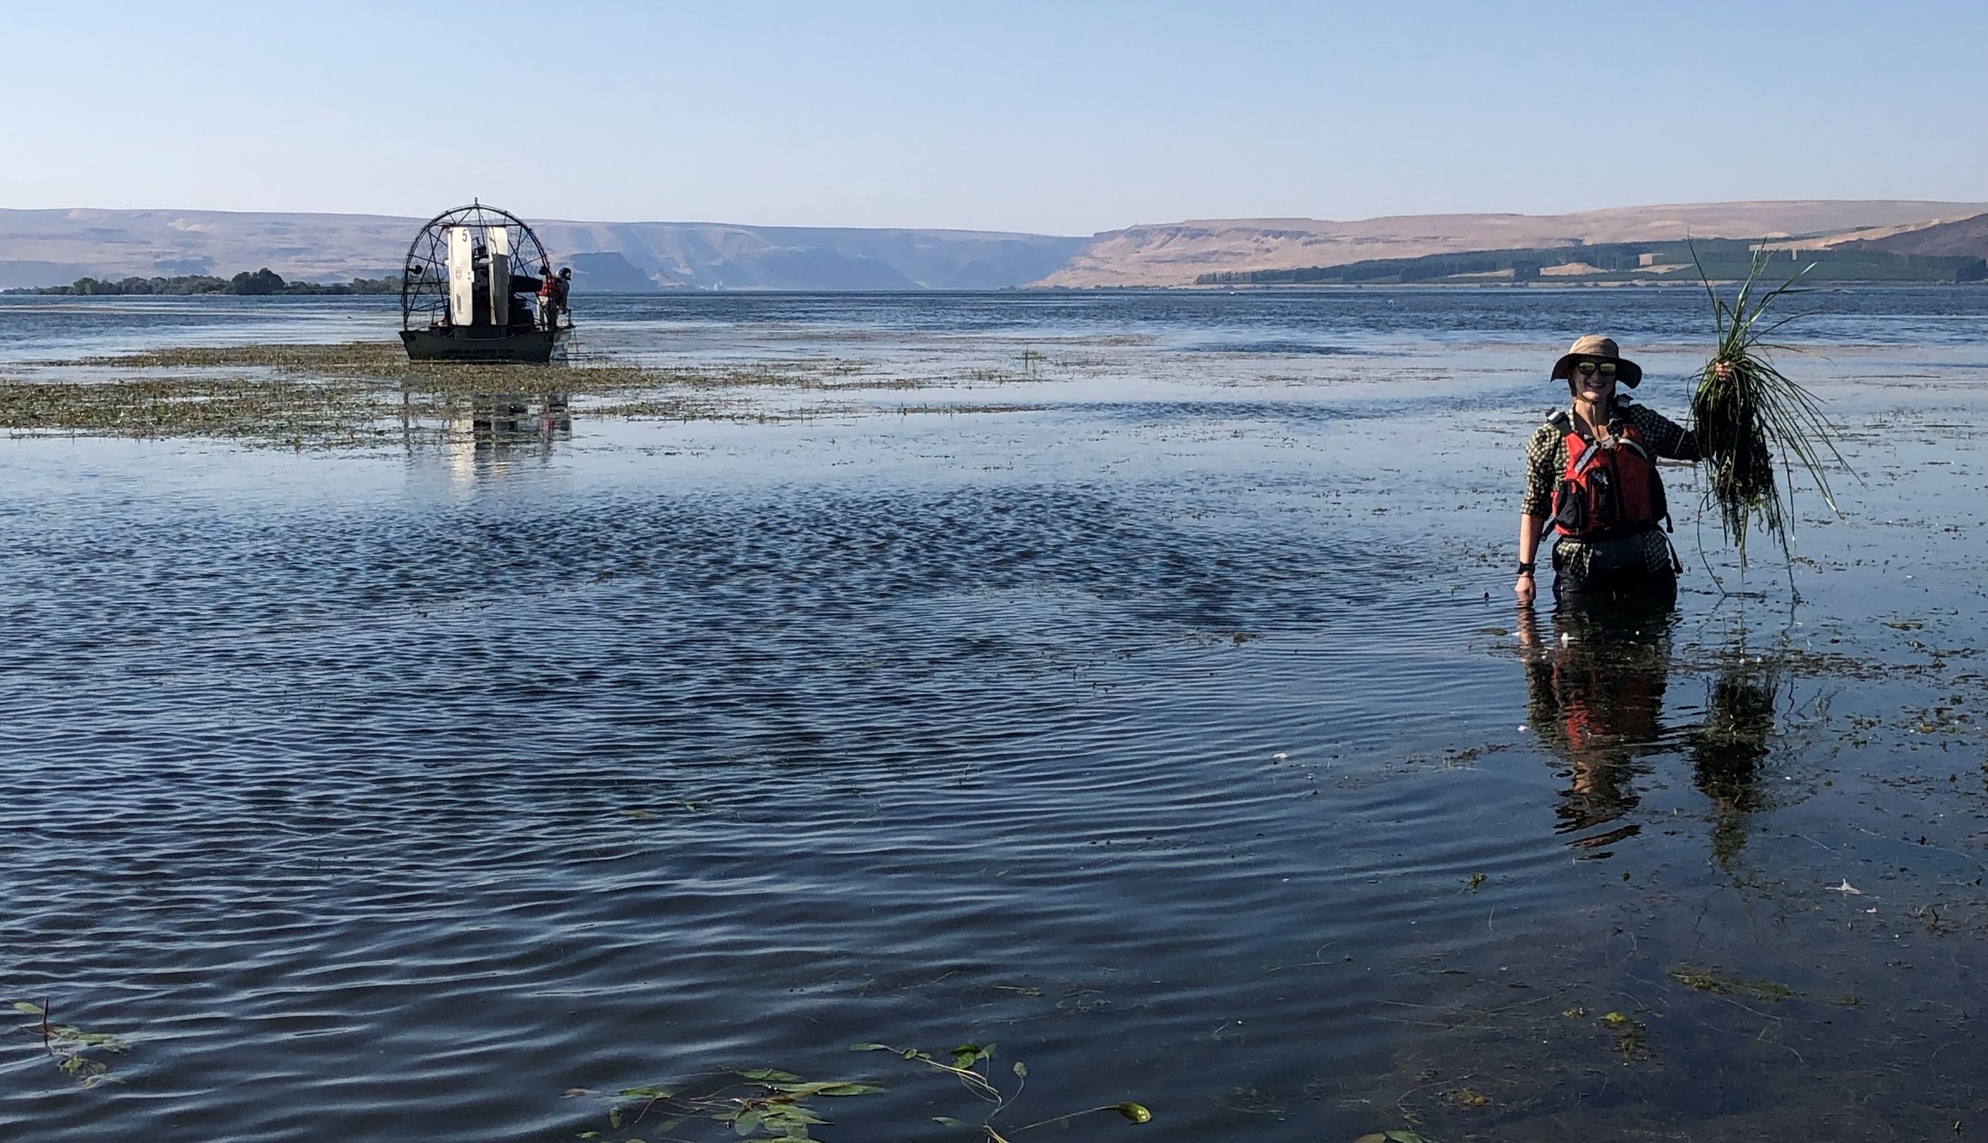
Who am I?
Brielle Thompson, PhD
Postdoctoral Fellow at the University of Missouri
Received PhD in June 2024 at the University of Washington (Advisors: Sarah Converse & Julian Olden)
Used decision analysis and mathematical/statistical population models to guide invasive species management
Current projects:
Developing invasive Prussian carp monitoring protocols using simulation
Guiding invasive carp management decisions in the lower Mississippi River/ Arkansas Red-White Rivers
Bills fan, dog Mom, distance runner

Slide 3

Introductions:
Name
Lab & Research
Why are you interested in decision analysis/structured decision making?
Fun hobby?

Slide 4
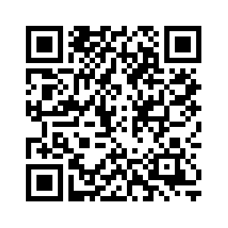
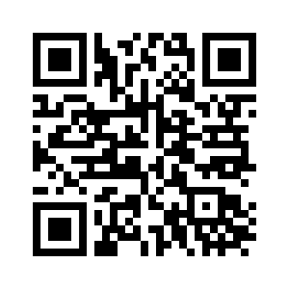
Logistics
Website (for most materials)
This will be my permanent location for course material
Lectures and exercises will be posted on the website (not weekly readings)
Canvas (for grading)
Use email/canvas to ask group questions
Grades will be posted on canvas
Weeky readings will be posted on canvas (FILES folder)
Timing:
Weekly on Tuesdays until October 17th
2-4pm ABNR 210

Slide 5
Logistics – weekly schedule *schedule subject to change
Week | Topic | PrOACT Step | Reading
1 | Motivation for Structured Decision Making - Quick PrOACT Story | None- Introduction | Gregory et al. 2012 Chapter 1
2 | Problem framing for natural resource decisions Tools discussed: Problem framing equation | Problem framing | Runge et al. 2020 Chapter 2 (Smith)
3 | Identifying and quantifying objectives for management decisions Tools discussed: Objectives hierarchy | Objectives | Gregory et al. 2012 Chapter 4
4 | Developing management alternatives and using models to identify the consequences of alternatives Tools discussed: Influence diagram, portfolios and strategy tables | Alternatives, Consequences | Gregory et al. 2012 Chapter 7
5 | Making tradeoffs amongst objectives Tools discussed: Multi-Criteria Decision Analysis, swing weighting | Tradeoffs | Runge et al. 2020 Chapter 5 (Converse)
6 | Decisions under uncertainty part 1 - Tools discussed: Decision trees, value of information | Advanced topic | Gregory et al. 2012 Chapter 10
7 | Decisions under uncertainty part 2 and risk - Tools discussed: Adaptive management, risk profiles | Advanced topic | Gregory et al. 2012 Chapter 10 & Runge et al. 2020 Chapter 13 (Runge)
8 | Rapid prototyping student presentation (elevator pitch) | All steps

Slide 6

Logistics – Week 7 conflict
Week 7 is currently October 7th
I will be attending TWS Annual Conference
Two options:
Extend class a week so the last week of class is October 21st
Have a guest lecturer for week 7 and keep final week of class as October 14th

Slide 7
Grading: Class graded out of 100
Participation (40 points)
5 points/week:
5 = Attended class or emailed me you are missing
3 = Emailed me you are missing class, but you already missed 4 classes
0 = Did not notify instructor you are missing class
Skills checks (28 points)
4 points per week (weeks 1-7)
4 = Completed skills check exercise either during class or by submitting via email
2 = Answered/completed skills check exercise for the wrong week
0 = Did not complete skills check exercise
Final presentation (32 points)
A (4.0) = 90-100
B (3.0) = 80-89
C (2.0) = 70-79
D (1.0) = 60-69
F (0) = < 60

Slide 8
Logistics – Final Presentation
During the final week of class, each student will be expected to informally discuss (~5 minutes) how components of decision analysis/ Structured Decision Making could be applied to their current graduate research project. The rapid prototyping grading rubric is found at the end of the syllabus.
See syllabus for grading rubric
We will revisit final project expectations most weeks

Slide 9
Course Learning Objectives
Identify the circumstances when Structured Decision Making could be useful
Comprehend key principles of Structured Decision Making (e.g., PrOACT, adaptive management)
Understand graphical models of natural resource decisions (e.g., objective hierarchies, influence diagrams, decision trees)
Identify tools that could be used for decision situations involving multiple objectives, uncertainty, risk, and repeated decisions
Apply the PrOACT process to graduate research topics with rapid prototyping
Developed by Brielle Thompson

Slide 10
Week 1: Introduction/ Motivation for Structured Decision Making

Slide 11
Humans are GOOD Decision Makers
Developed by Michael C. Runge

Slide 12
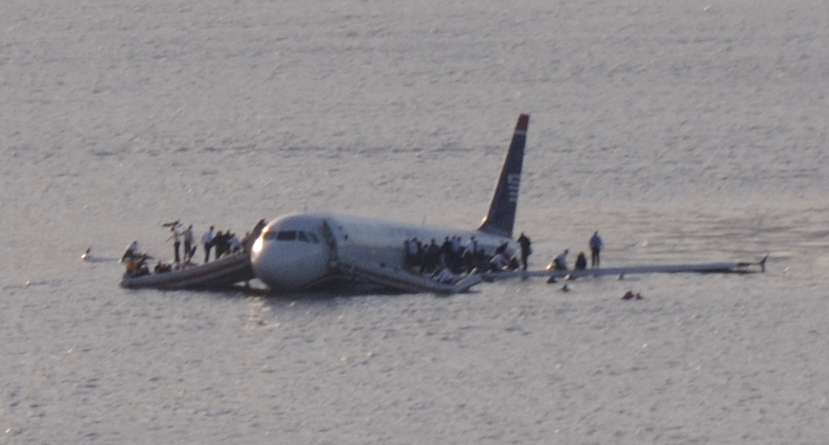
US 1549, 15 January 2009
A.G. Lam Pak Ng, CC BY 2.0
Developed by Michael C. Runge
Notes:
The Miracle on the Hudson. On January 15, 2009, Chesley “Sully” Sullenberger landed an Airbus A320
in the Hudson River after both engines were disabled by bird strikes, saving all 155 people aboard. The
time between the impact with the geese and the water landing was 4 minutes. Captain Sullenberger
and his co-pilot had less than a minute to make an irreversible decision about whether to land in the
river or attempt at landing at nearby Teterboro airport. Intensive computer simulations later
conducted by the National Transportation Safety Board showed that it would not have been possible
to safely land at the airport. How did the pilots make a decision in under a minute that took a
supercomputer days to evaluate?

Slide 13

Blink
Gladwell argues that our intuitive decision-making skills are excellent in certain circumstances
Isn’t the ability to make good decisions the hallmark of our species?
Developed by Michael C. Runge

Slide 14
Humans are BAD Decision Makers
Developed by Michael C. Runge

Slide 15
Quick Puzzle to Test Your Problem Solving
(Source: The New York Times)
I’ve chosen a rule that some sequences of three numbers obey — and some do not. Your job is to guess what the rule is.
The sequence: 1, 2, 4 obeys the rule.
Give me 3 numbers and I will tell you if they obey the rule
Can you describe the rule or do you want to test another sequence?
Developed by Michael C. Runge
Notes:
We’ve chosen a rule that some sequences of three numbers obey — and some do not. Your job is to guess what the rule is.
[the rule is each number is larger than the previous]
We’ll start by telling you that the sequence 2, 4, 8 obeys the rule.
Give me 3 numbers and I will tell you if they obey the rule
[typically, someone will say a sequence that doubles the previous number. To which I will say “yes, that obeys the rule”]
Can you describe the rule or do you want to test another sequence?
[Typically, folks will stop and say the rule is each number is double the previous. They tend to stop because people do not want to get it wrong; they want to be confirmed not refuted.]

Slide 16
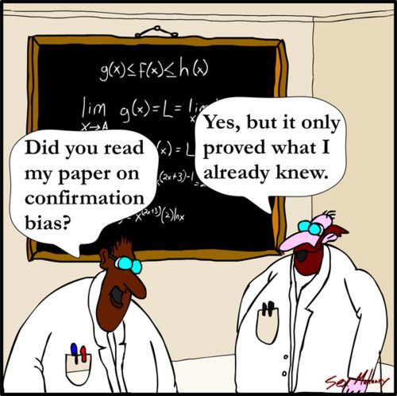
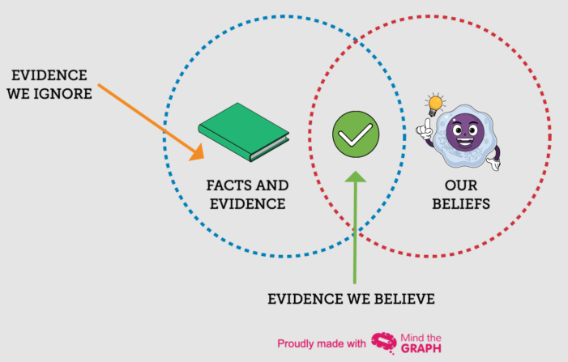
Cognitive Biases
Confirmation bias
Focusing attention on evidence that confirms your beliefs
Example: A policymaker who believes logging is harmful may ignore data showing that sustainable forestry practices can preserve ecosystems
Developed by Brielle Thompson
Notes:
Confirmation bias in invasive species: Imagine a researcher studying the impact of invasive species on local ecosystems. Suppose the researcher believes that a specific invasive plant species is the main cause of decline in native plant diversity. As they conduct their study, they focus primarily on data that shows the invasive plant's negative effects, while overlooking or undervaluing evidence that points to other factors (like climate change or habitat destruction) contributing to the decline in native plants. By giving more weight to the evidence that confirms their hypothesis and ignoring conflicting evidence, the researcher is exhibiting confirmation bias.

Slide 17
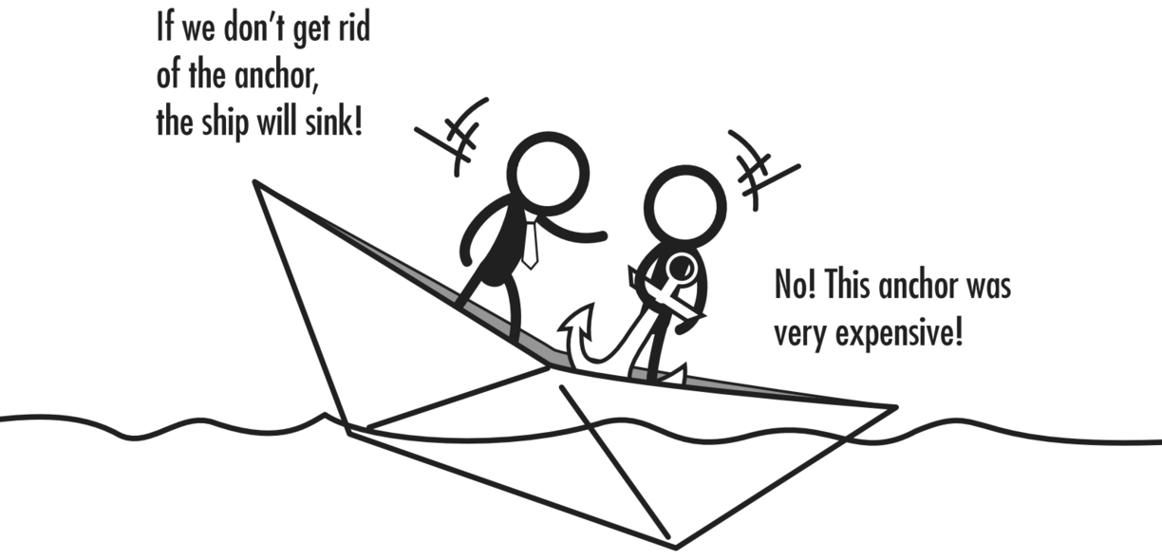
Cognitive Biases
Confirmation bias
Sunk costs
Deciding based on past
investments not future returns
Example: A marine conservation group invests heavily in a custom underwater drone system to monitor coral reef health. After deployment, they discover that the drones are unreliable in strong currents and produce lower-quality data than newer, off-the-shelf alternatives, but they continue to use their custom system.
Developed by Brielle Thompson
Notes:
Sunk cost: we are all probably familiar with projects like this in conservation. Where we continue to fund projects that are not yielding good results, simply because of the financial investments already made

Slide 18
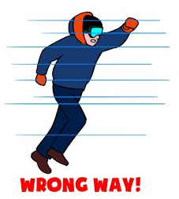
Cognitive Biases
Confirmation bias
Sunk costs
Escalation of commitment
Continuing to invest in a suboptimal choice
Example: Expanding a failing species reintroduction program to more regions, hoping it will eventually succeed and validate the original plan
Productivity Guy
Developed by Brielle Thompson
Notes:
Escalation of commitment: similar to sunk costs, but is more of a behavioral and emotional response to committing to a suboptimal choice.

Slide 19

Cognitive Biases
Confirmation bias
Sunk costs
Escalation of commitment
Status quo bias
Preference to maintain current actions
Example: A farming region has used flood irrigation for decades, a method that consumes large amounts of water and leads to runoff and soil erosion. Despite the availability of more efficient technologies like drip irrigation, many farmers resist switching
Developed by Brielle Thompson
Notes:
Escalation of commitment: similar to sunk costs, but is more of a behavioral and emotional response to committing to a suboptimal choice.

Slide 20
Quiz!
1,879 x 79 = ?
1,479,512
87 x 79 = ?
6,873
Developed by Brielle Thompson

Slide 21
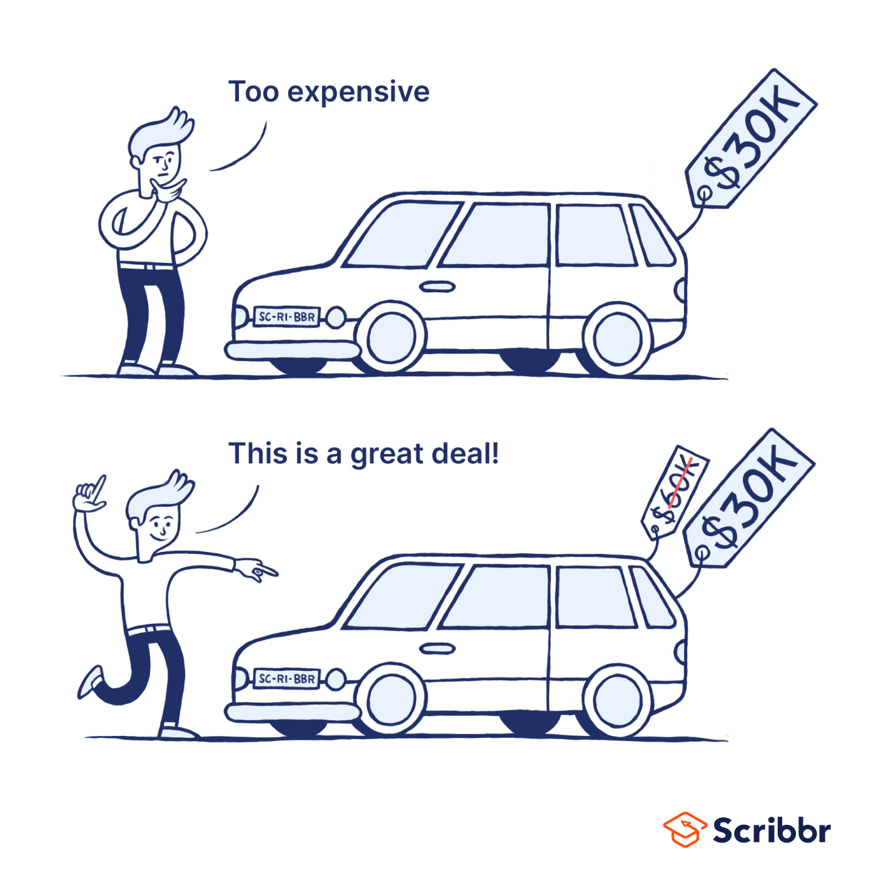
Errors in forecasting
Anchor and adjust
We tend to anchor on the first piece of information and adjust
Example: A conservation team conducts a survey of a threatened bird species and estimates the population to be around 1,000 individuals. This number becomes the anchor for future discussions and planning. Years later, new surveys suggest the population may be closer to 600, but stakeholders and policymakers continue to base decisions on the original estimate
Developed by Brielle Thompson
Notes:
Representative heuristic – example, not individualizing management plans

Slide 22




Quiz
Which of these is more common?
People getting the stomach flu each year
People getting food poisoning each year
On average, more people per year get food poising vs the flu
(Piedmont healthcare)
Developed by Brielle Thompson
Notes:
https://www.piedmont.org/living-real-change/the-difference-between-the-stomach-flu-and-food-poisoning

Slide 23
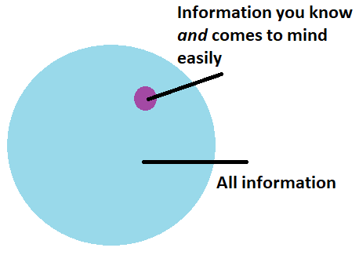
Errors in forecasting
Anchor and adjust
Availability heuristic
Judge the probability of events by the ease of recall
Example: After a high-profile wildfire receives extensive media coverage, a local government rushes to implement strict fire suppression policies across all forested areas, even in regions where fire is a natural and necessary
Statistics By Jim
Developed by Brielle Thompson
Notes:
Representative heuristic – example, not individualizing management plans

Slide 24
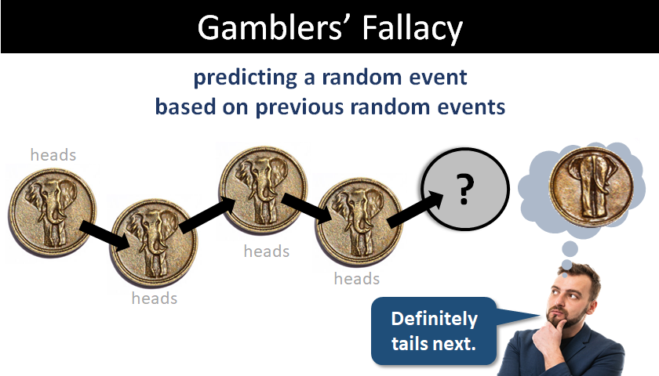
Errors in forecasting
Anchor and adjust
Availability heuristic
Representativeness heuristic
Judge the probability of an event by the extent to which it resembles a typical case
E
xample: After experiencing five consecutive dry years, a conservation planner assumes a wet year is “due” soon, and delays implementing strict conservation measures.
Critical Thinking
Developed by Brielle Thompson
Notes:
Take Lisa, a bright philosophy graduate deeply concerned with discrimination and social justice. When given the option, we are much more likely to guess that she is both an active feminist and a bank teller, rather than just a bank teller. This is because of representativeness: the fact that Linda resembles a prototypical member of the feminist movement skews our ability to predict the probability of her career. Statistically, Lisa is more likely to be just a bank teller than a bank employee and a feminist, but because her description fits our mental image of a feminist, we mistakenly believe that the latter is more probable.

Slide 25
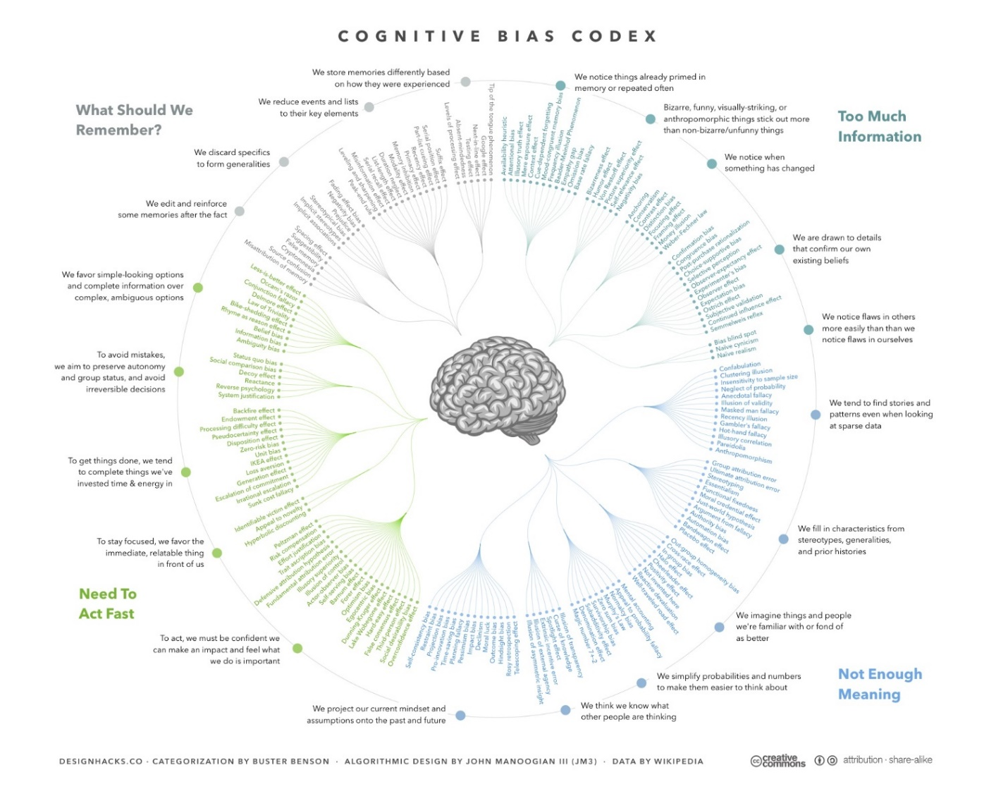
Cognitive Biases

Slide 26
Activity: Cognitive Biases
Read the following statements:
“We’ve always used this method to manage the forest”
“We saw a documentary about coral bleaching, so we need to focus all our efforts on reef conservation”
“We’ve already spent $2 million on this wildlife corridor”
Discuss in groups:
Identify the type of bias
status quo/sunk cost/availability heuristic
How might these biases affect conservation decisions?
Developed by Brielle Thompson

Slide 27
Humans are both GOOD and BAD decision makers
Developed by Michael C. Runge

Slide 28
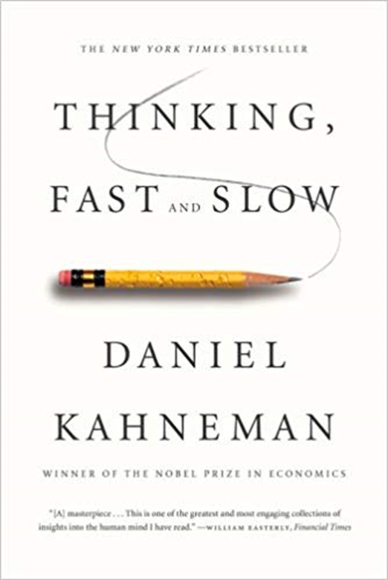
Human Decision Making
Daniel Kahneman won the 2002 Nobel Prize in Economics for work he did in partnership with Amos Tversky on how people make decisions
Developed by Michael C. Runge

Slide 29
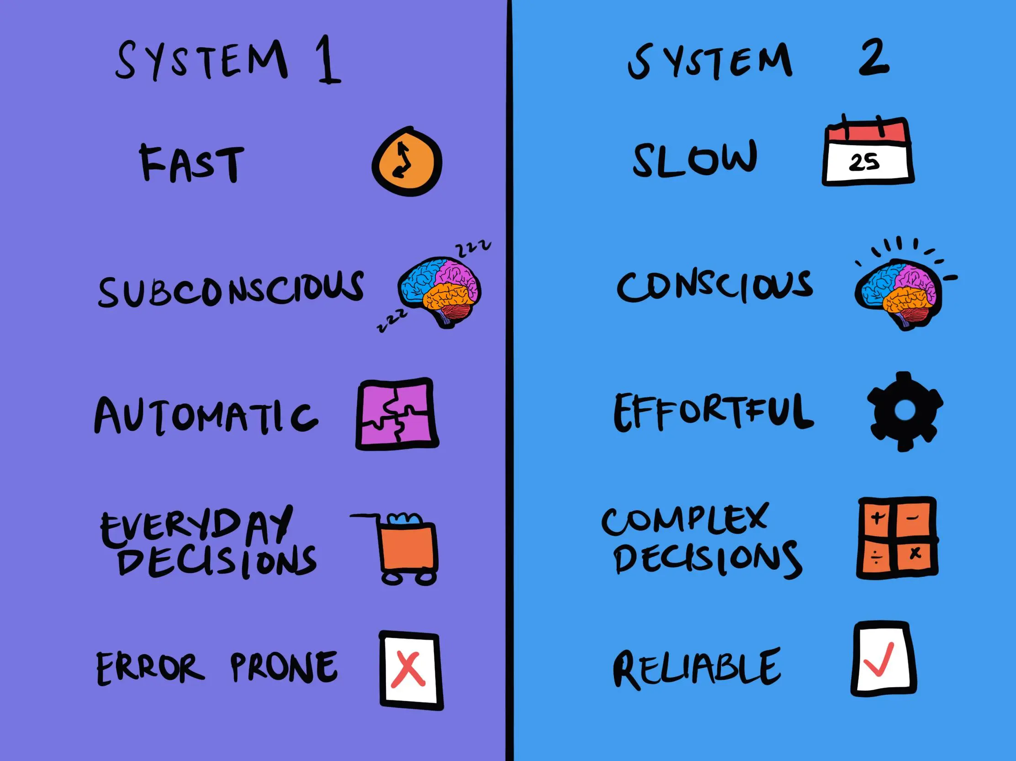
Systems 1 and 2
Kahneman and Tversky postulated that we have two cognitive systems
Developed by Brielle Thompson
The Decision Lab

Slide 30
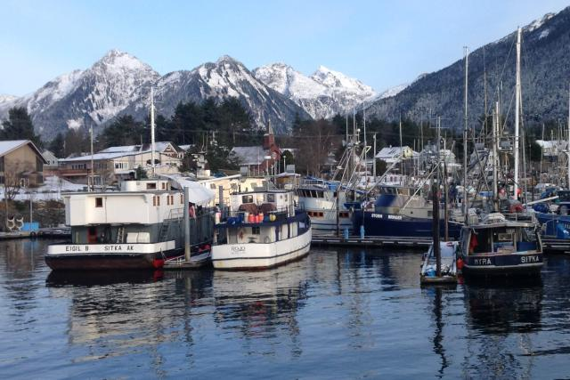
Activity: System 1 and 2 Thinking
Natural resource scenario: A coastal town relies on fishing for income
System 1 response:
“Let's catch as many fish as we can while they are here”
System 2 response:
“Let’s monitor its population and set quotas to ensure sustainability”
The fishing community of Sitka, Alaska
Discuss in groups:
What are the short-term benefits of system 1 thinking?
What are the long-term consequences of system 1 thinking?
What are the pros/cons of system 2 thinking?
NOAA Fisheries/Marysia Szymkowiak
Developed by Brielle Thompson

Slide 31
Typical approaches for hard decisions (system 2) in natural resources
Science-based decision making
Use of scientific experiments to solely inform decisions
Pros:
Used for “science” based decisions
Cons:
“Science provides no basis for dealing with moral or value-based choices”
Consensus-based decision making
Often uses deliberation practices to bring a group to a consensus agreement
Pros:
Gets to an end point quickly
Cons:
Doesn’t solve the root of conflict
Conflicting views are thought of as “problems to be hushed”
Economic-based decision making
Often uses economic techniques to translate a problem to monetary units to identify the least costly approach
Pros:
Analytical and creates scores for each potential action
Cons:
Does not typically involve scientific components
Transforms everything to $s
Developed by Brielle Thompson & See Week 1 reading (Gregory et al. 2012 Chapter 1)

Slide 32
A good approach for hard decisions (system 2) in natural resources
Structured Decision Making (SDM)
“An organized, inclusive, and transparent approach to understanding complex problems and generating and evaluating creative alternatives”
Pros:
Provides an in depth understanding of values (what is important) and consequences (what is likely to happen if an alternative is implemented)
Clarifies actions and their implications across a range of relevant concerns (your values)
Cons:
Doesn’t assure a good result (but no decision frameworks can do this!)
But SDM helps inform a “sound decision process” where you will “1) Do better in the long run than if you do not, & 2) Be in a position to defend your decision even if results are poor” (Conroy and Peterson 2013)
Developed by Brielle Thompson & See Week 1 reading (Gregory et al. 2012 Chapter 1)

Slide 33
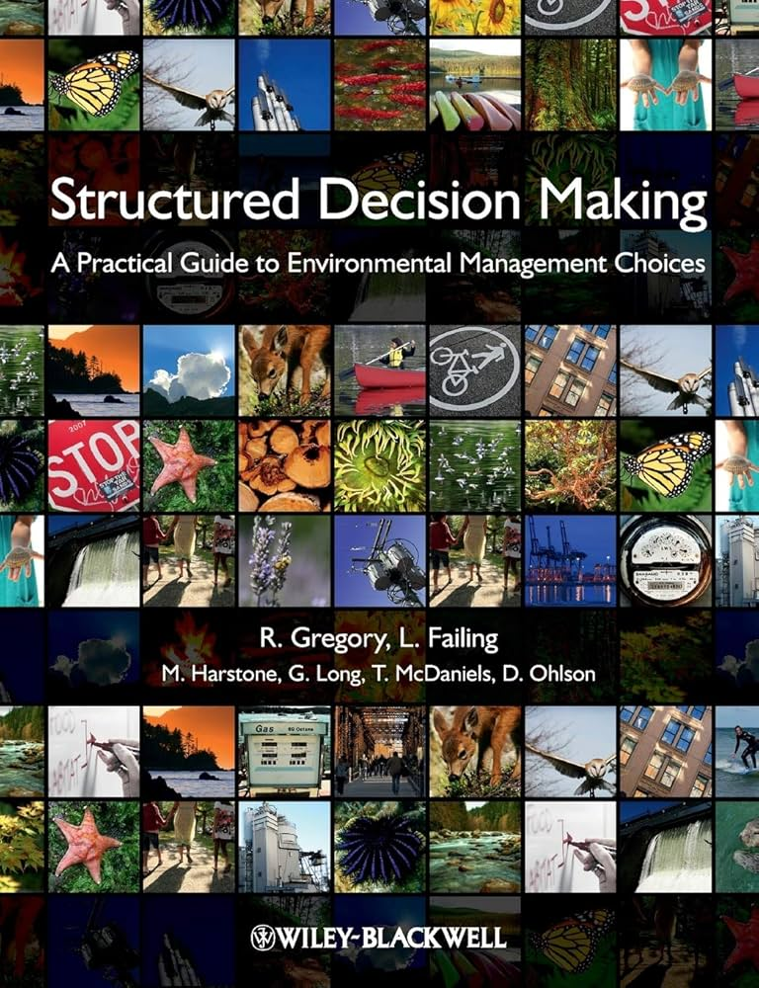
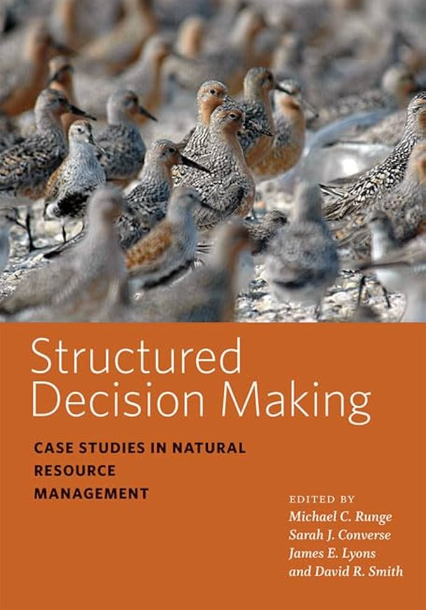
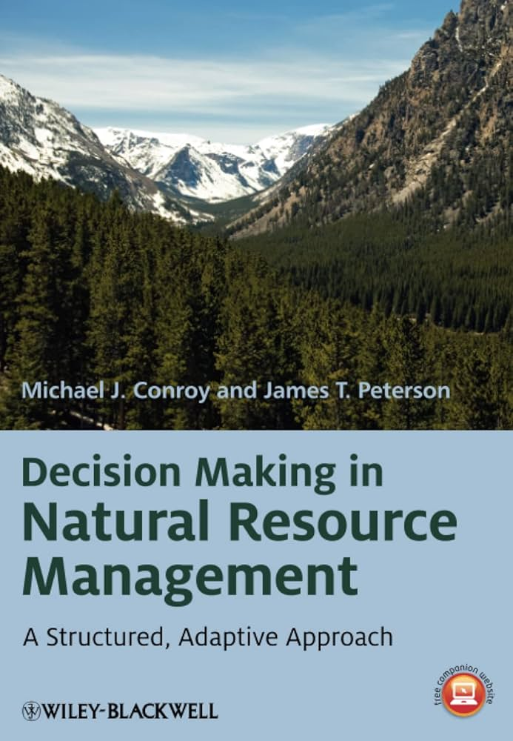

Structured Decision Making (SDM)
Leverages our system 2 brain
Structured Decision Making refers to the use of the principles of normative decision theory
Normative decision theory: studies how people should make decisions
Decision analysis is “a formalization of common sense for decision problems which are too complex for informal use of common sense.”
Decision Analysis and Structured Decision Making (SDM) are synonymous
Developed by Michael C. Runge

Slide 34


Two key elements of Structured Decision Making
1. Values-focused
Objectives are discussed first
Contrasts with alternative-focused methods
2. Problem decomposition
Break problem into components, separating science from values
Complete relevant analysis
Recompose the parts to make a decision
PrOACT
Developed by Michael C. Runge

Slide 35
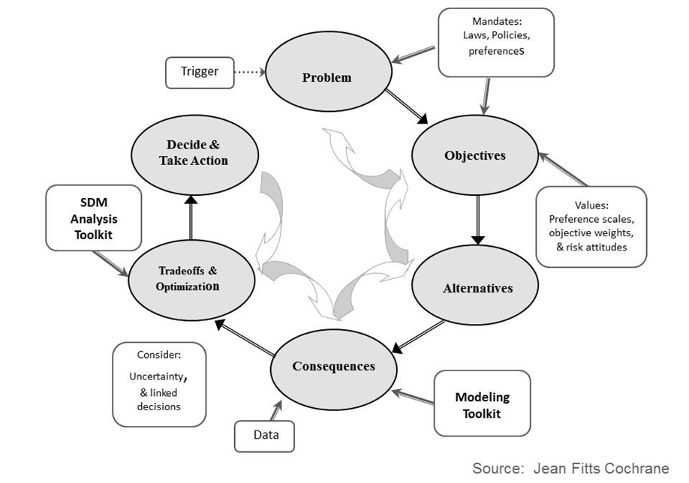
PrOACT
Define the Problem
Determine the Objectives
Identify Alternatives
Forecast the Consequences
Evaluate the Trade-offs
Additional steps​
Return to previous stages​
Sensitivity analysis​
Make the decision and monitor the outcome​
Developed by Michael C. Runge

Slide 36
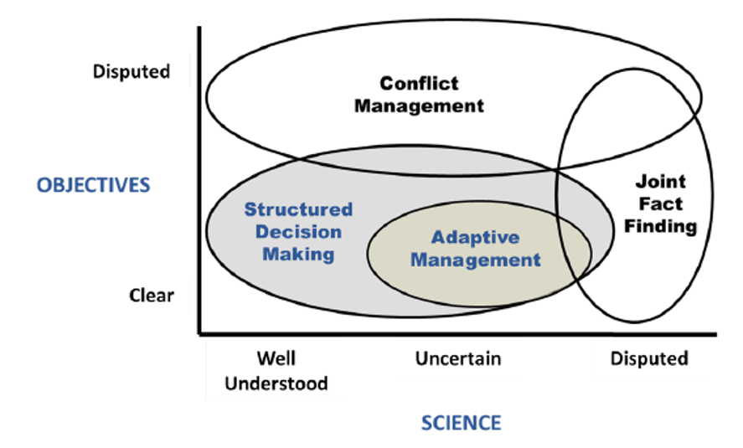
When is SDM appropriate?
For decisions involving a single decision-making body
But there can be multiple “stakeholders” or interest groups
When there is a desire to have transparency and legacy in the decision-making process
(From Runge et al. 2013)
Developed by Michael C. Runge
Notes:
Joint fact finding: work together to gather, analyze, and interpret data from neutral experts, aiming to build a shared understanding of the facts and potentially reach a consensus on the issue at hand

Slide 37
When is SDM NOT appropriate?
When there are multiple, competing decision makers
When institutional buy-in is impossible
Should not be used to “prescribe” a decision
Rather SDM is used to aid/inform decision makers
(From Runge et al. 2013)
Developed by Michael C. Runge
Notes:
Joint fact finding: work together to gather, analyze, and interpret data from neutral experts, aiming to build a shared understanding of the facts and potentially reach a consensus on the issue at hand

Slide 38
SDM usefulness:
SDM helps handle impediments including:
Hidden objectives
You don’t reveal what you want
Competing objectives
You have multiple things you care about
Complex alternatives
Your management actions are too confusing
Important uncertainties
There are biological, management, environmental uncertainties
Developed by Michael C. Runge, Brielle Thompson
Notes:
Joint fact finding: work together to gather, analyze, and interpret data from neutral experts, aiming to build a shared understanding of the facts and potentially reach a consensus on the issue at hand

Slide 39
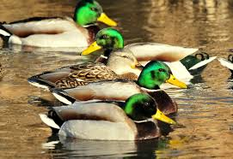
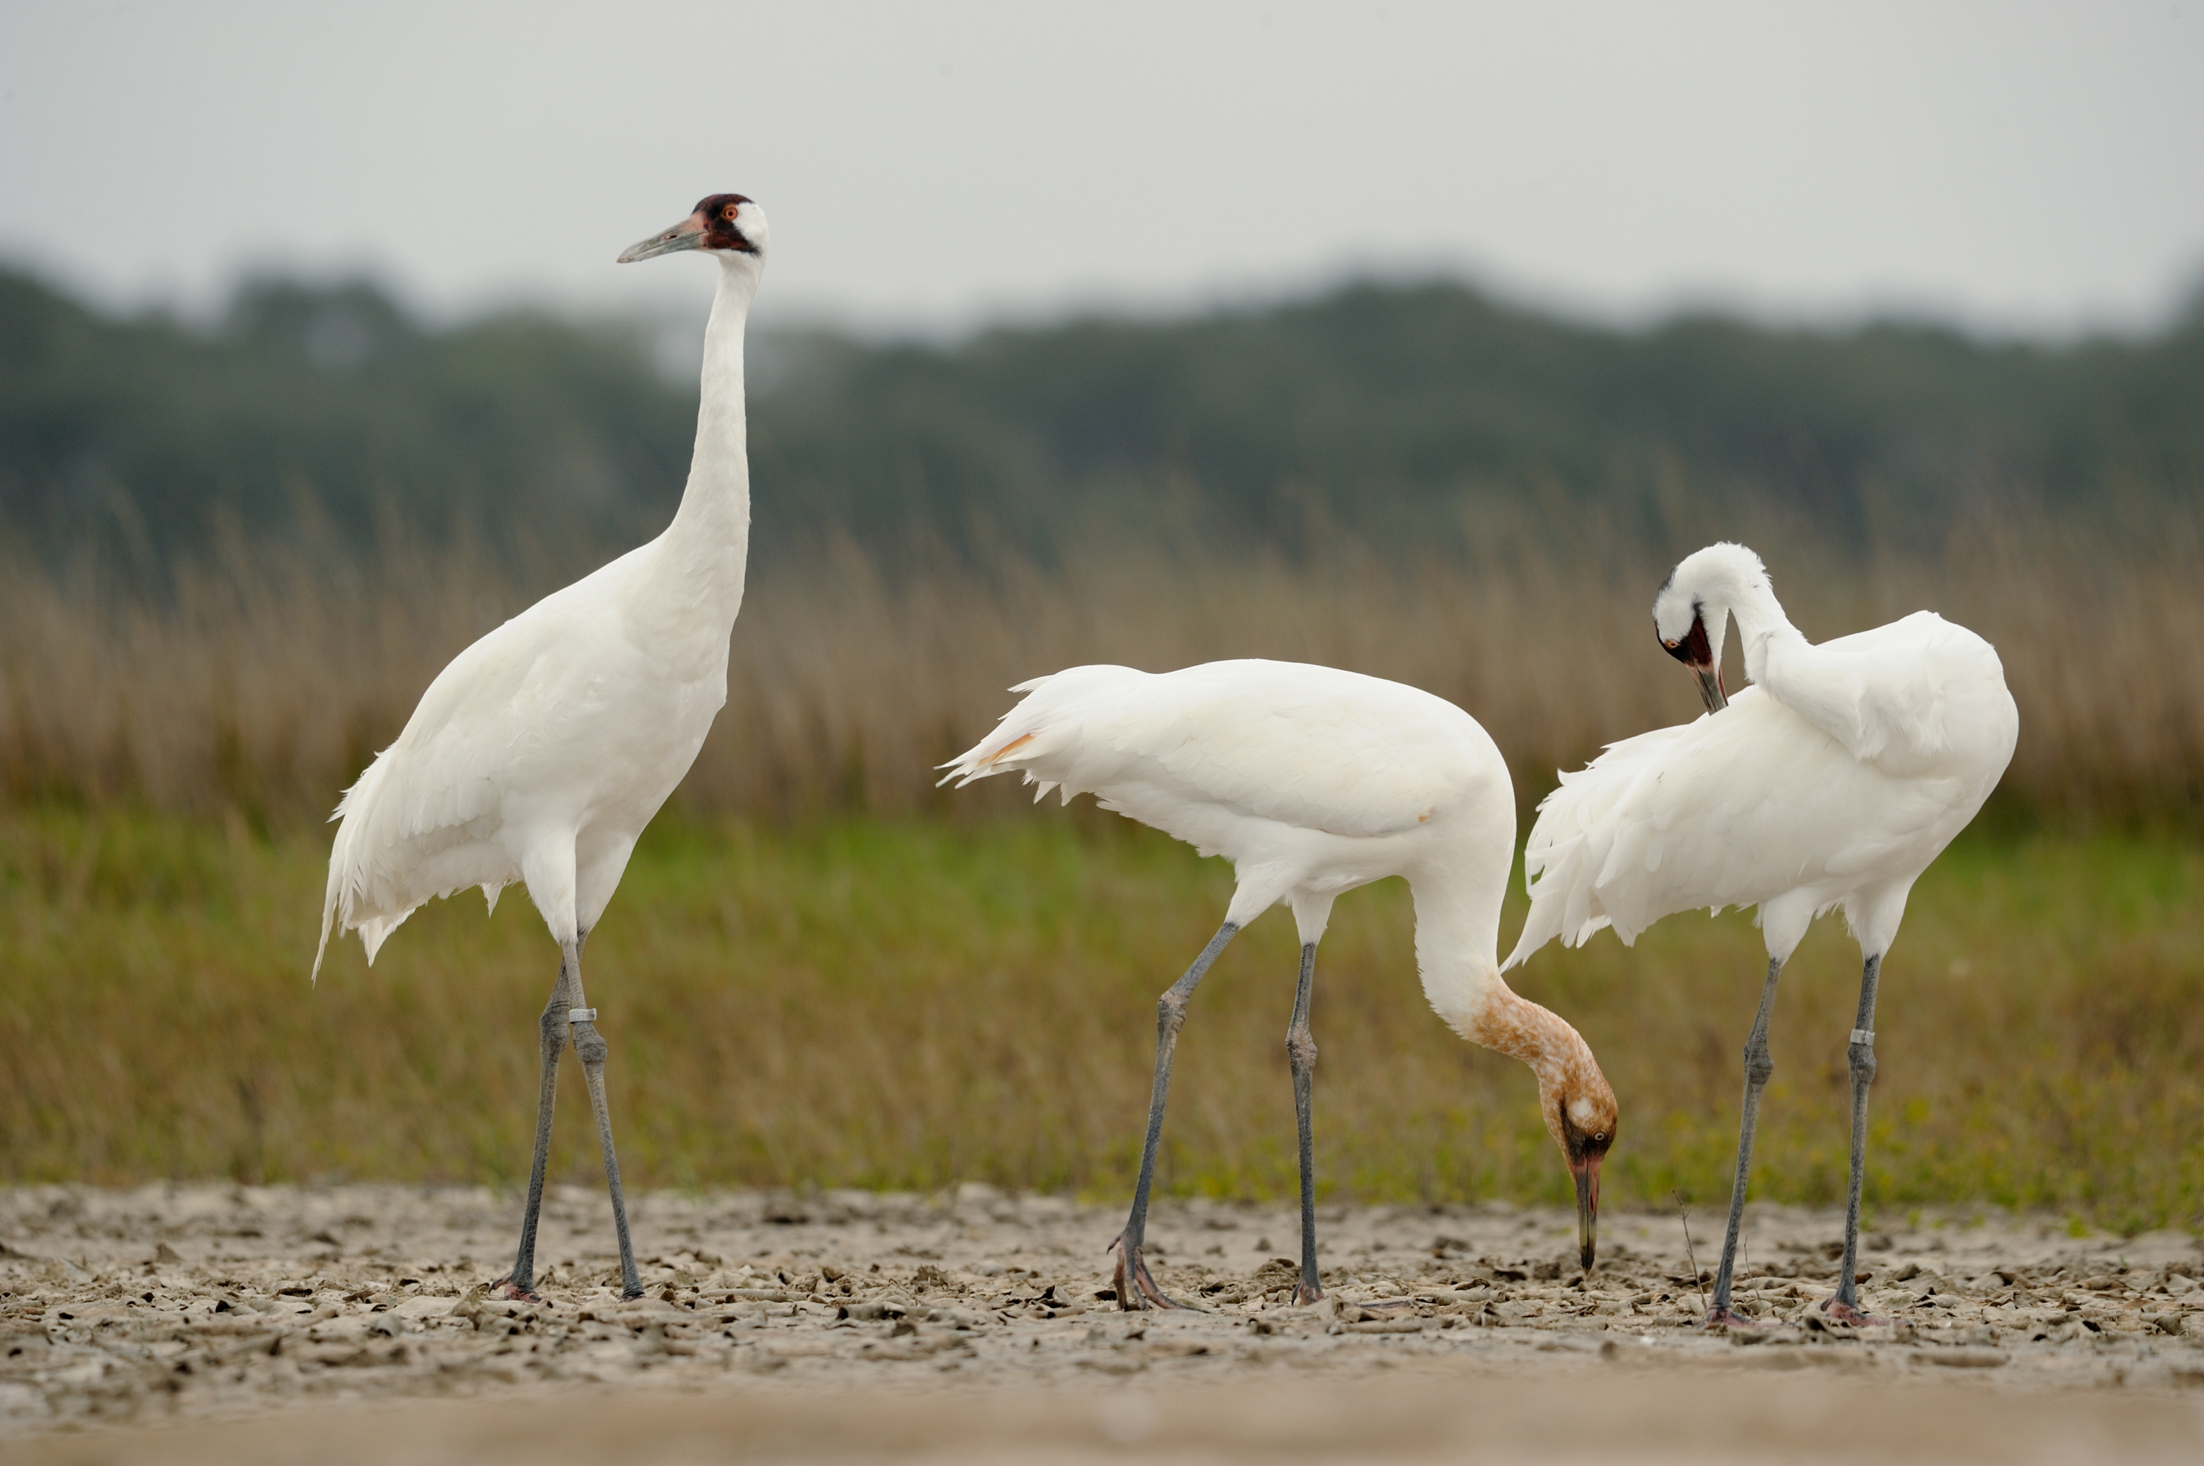
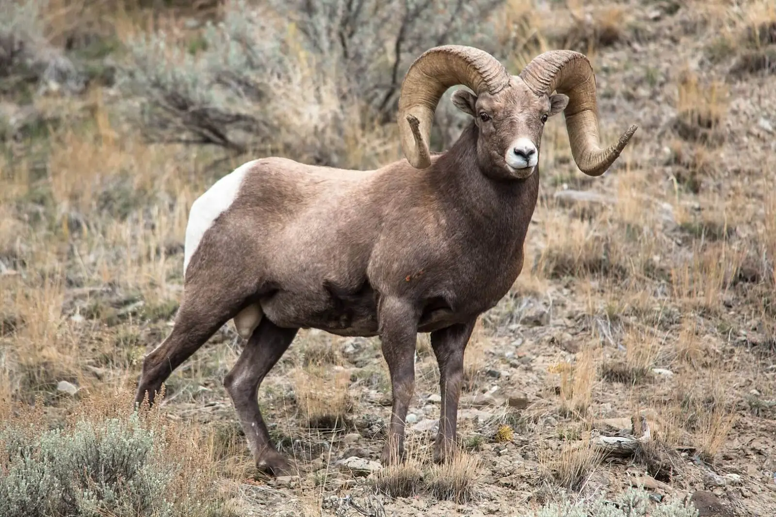
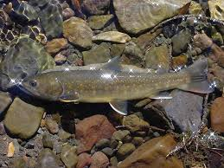
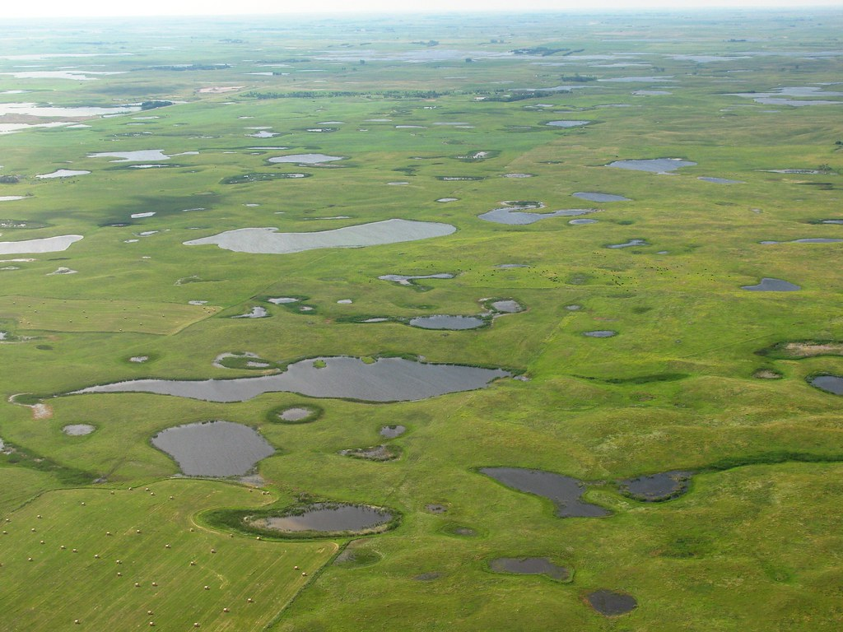
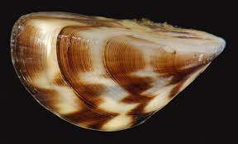
SDM examples- natural resources
Creative Commons Licenses photos
Waterfowl harvests
(Williams and Johnson 1995)
Whooping crane management
(Moore et al. 2008)
Bighorn Sheep disease mitigation
(Sells et al. 2016)
Bull trout reintroduction
(Brignon et al. 2017)
Dreissenid mussel management
(Sepulveda et al. 2022)
Prairie Pothole wetland management
(Hunt et al. 2020)
Developed by Brielle Thompson

Slide 40

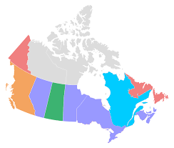






SDM – who uses it?
Creative Commons Licenses photos
Canadian Provincial Governments
US Federal Agencies
& USGS Cooperative Fish and Wildlife Research Faculty
US State Agencies
Consulting Firms
Other countries
Developed by Brielle Thompson

Slide 41






SDM examples- beyond natural resources
Creative Commons Licenses photos
Buying a car
Choosing a college
Career decisions
Deciding dinner plans
Buying a house
Making travel plans
Developed by Brielle Thompson

Slide 42
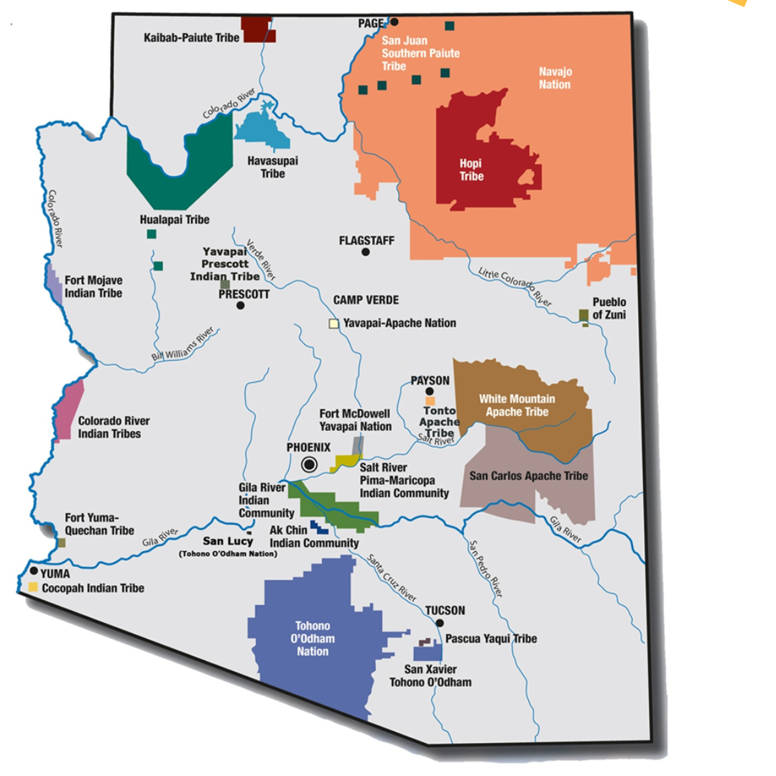
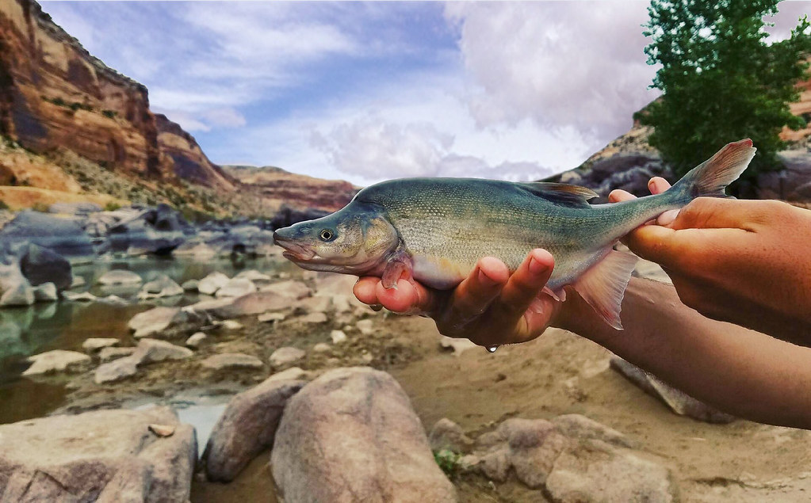
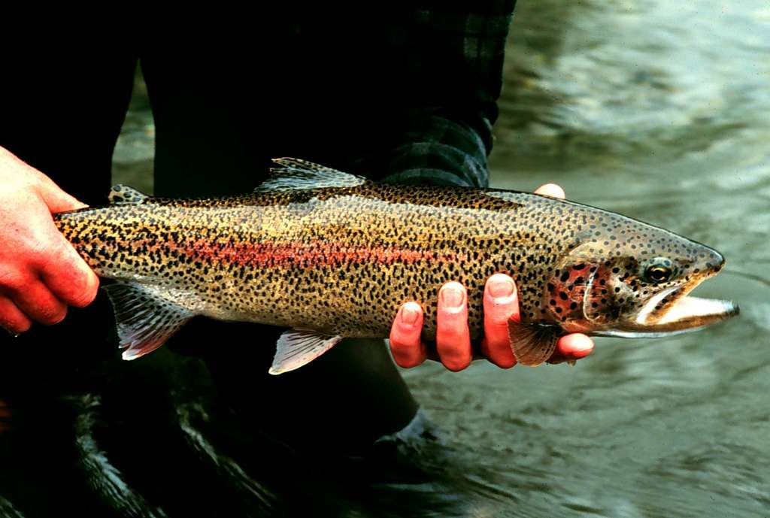
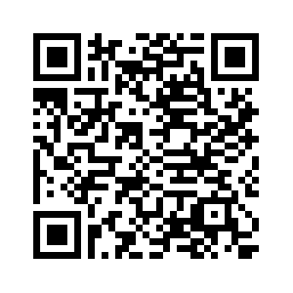
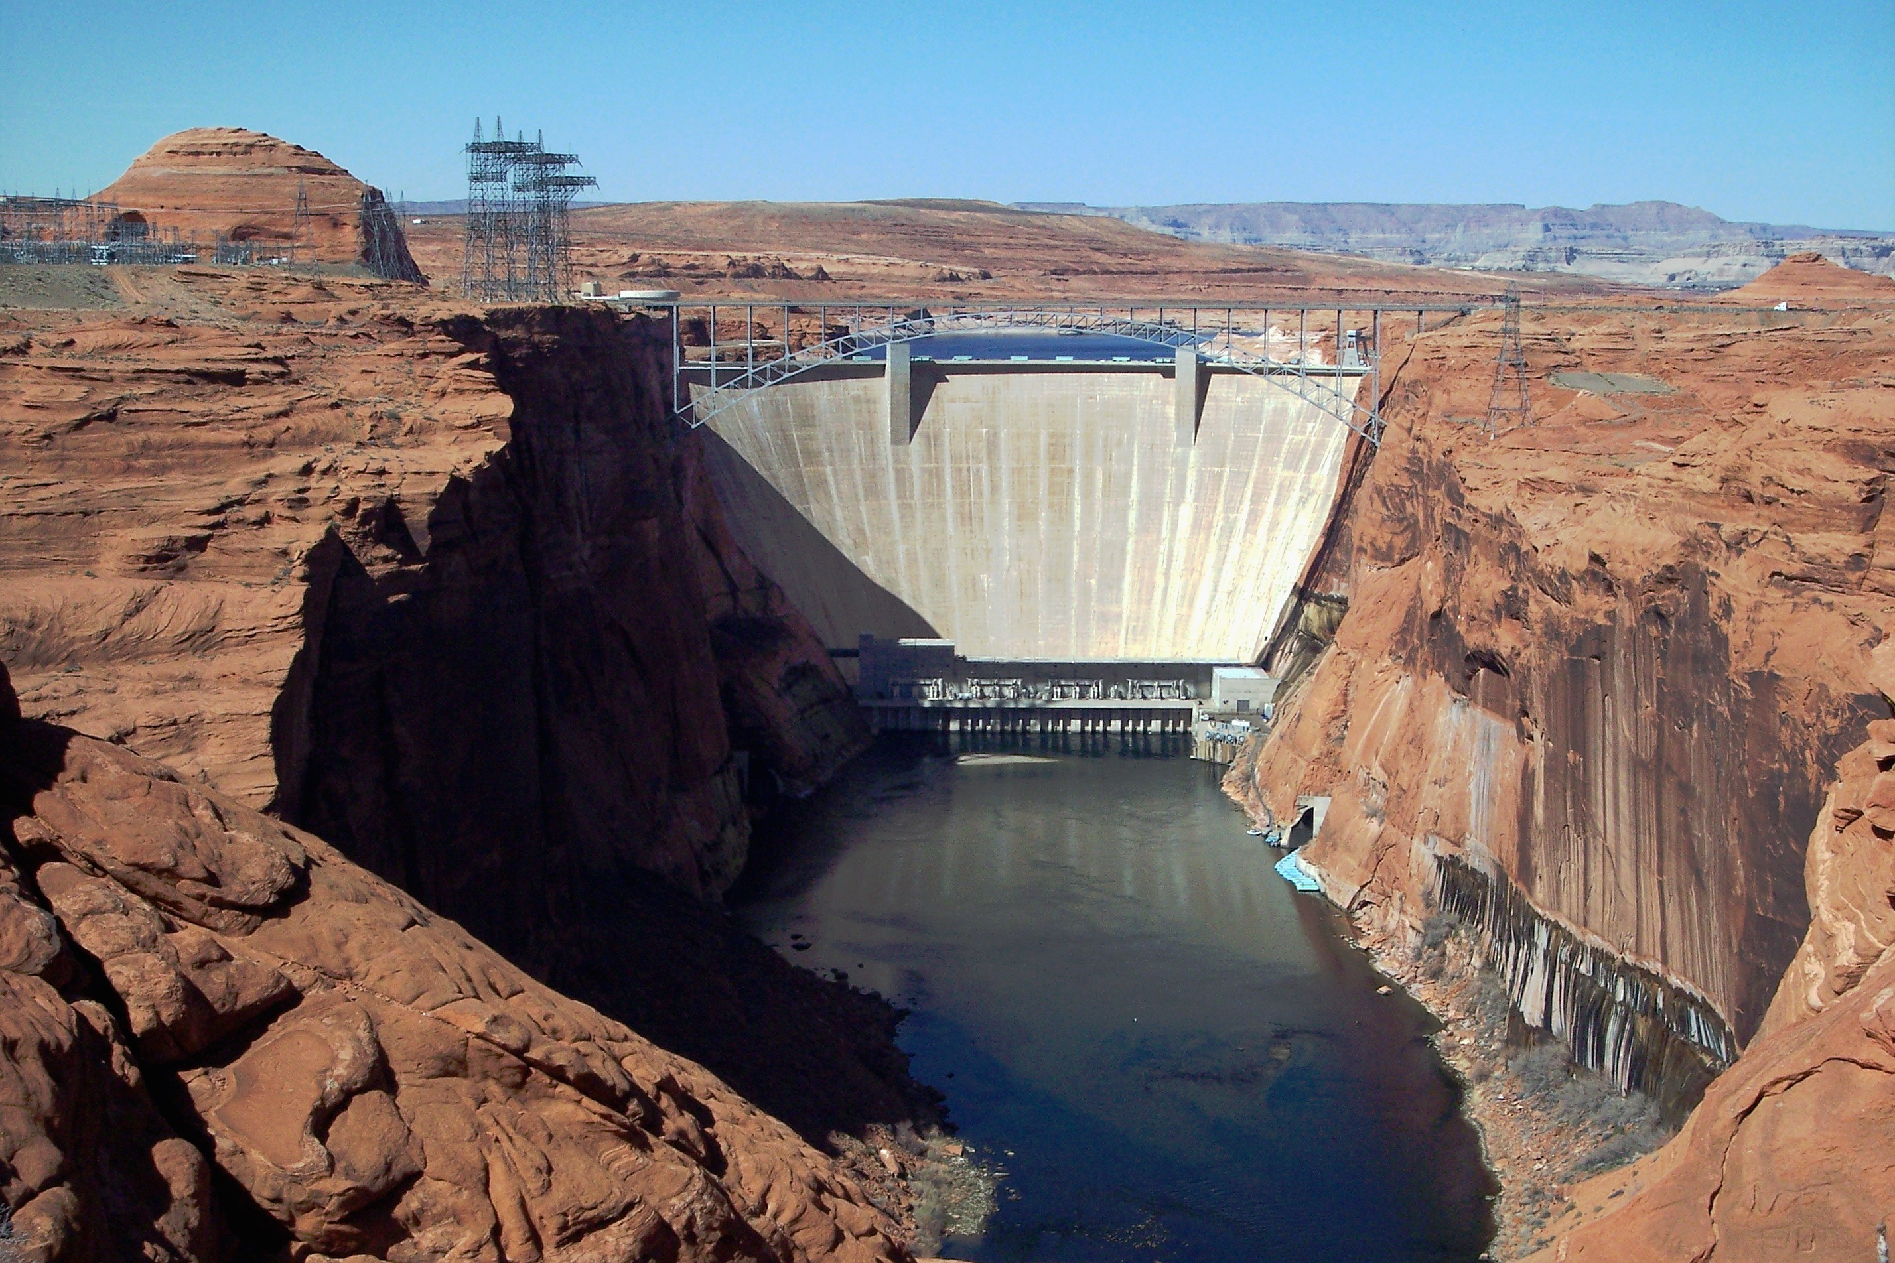
PrOACT Story –abridged
Creative Commons Licenses photos
SDM project: Non-native fish control below glen canyon dam
Arizona Department of Education
(Runge et al. 2011)

Slide 43
SDM project: Non-native fish control below glen canyon dam
Problem
framing
Decide & Implement
Articulate
Objectives
Monitor, learn, & update models
Perform
Tradeoffs
Identify
Alternatives
Predict
Consequences
Adapted, modified, and simplified from Runge et al. 2011

Slide 44
SDM project: Non-native fish control below glen canyon dam
Problem framing statement:
Problem
framing
Bureau of reclamation is trying to make decisions regarding invasive trout management to achieve recovery of humpback chub populations over the next 5 years in the Little Colorado River, below the Glen Canyon Dam considering sacred sites and spiritual values of local Native American tribes (e.g., avoid taking of life), humpback chub recovery, trout invasion, recreational values, cost, and local economies.
Adapted, modified, and simplified from Runge et al. 2011

Slide 45
SDM project: Non-native fish control below glen canyon dam
Objectives:
Problem
framing
Fundamental objectives
Articulate
Objectives
Maximize resources to protect tribal sacred sites and spiritual values
Maximize native species integrity
Maximize recreation
Minimize cost
Adapted, modified, and simplified from Runge et al. 2011

Slide 46
SDM project: Non-native fish control below glen canyon dam
Objectives (objectives hierarchy)
Fundamental objectives
Maximize resources to protect tribal sacred sites and spiritual values
Maximize native species integrity
Maximize recreation
Minimize cost
Means objectives
Min. taking of life
Min. wilderness days lost
Min. trout removal cost
Max. dam power production
Max. HBC population
Min. trout population
Max. fish catch
Process objectives
- Be respectful of tribal values and rituals
Strategic objectives
-Operate within the authority, capabilities, and legal responsibility of the Bureau of Reclamation
- Follow ESA compliances
Adapted, modified, and simplified from Runge et al. 2011
Notes:
https://pubs.usgs.gov/of/2011/1012/pdf/ofr20111012.pdf#page=17.21

Slide 47
SDM project: Non-native fish control below glen canyon dam
Alternatives:
Problem
framing
THEMES:
a) Trout management
1. None
2. 25 fish/acre killed
3. 50 fish/acre killed
4. 25 fish/acre removed via helicopter
5. 50 fish/acre removed via helicopter
Articulate
Objectives
b) HBC habitat
1. None
2. Plant native vegetation
3. Build sediment curtain
Identify
Alternatives
c) Recreation
1. No changes
2. Remove 50 boating days per year
3. Close wilderness areas for 1 year
4. Prohibit boating for 1 year
Adapted, modified, and simplified from Runge et al. 2011

Slide 48
SDM project: Non-native fish control below glen canyon dam
Alternatives:
----------------------THEMES-----------------------
a) Trout management | b) HBC habitat | c) Recreation
1. None | 1. None | 1. No changes
2. 25 fish/acre killed | 2. Plant native vegetation | 2. Remove 50 boating days per year
3. 50 fish/acre killed | 3. Build sediment curtain | 3. Close wilderness areas for 1 year
4. 25 fish/acre removed via helicopter |  | 4. Prohibit boating for 1 year
5. 50 fish/acre removed via helicopter
Strategy table:
Strategy | A) Trout management | B) HBC habitat | C) Recreation
A (none) | a1 | b1 | c1
B | a2 | b2, b3 | c2
C | a3 | b2, b3 | c3
D | a4 | b2, b3 | c4
E | a5 | b2 | c3, c4
Adapted, modified, and simplified from Runge et al. 2011

Slide 49
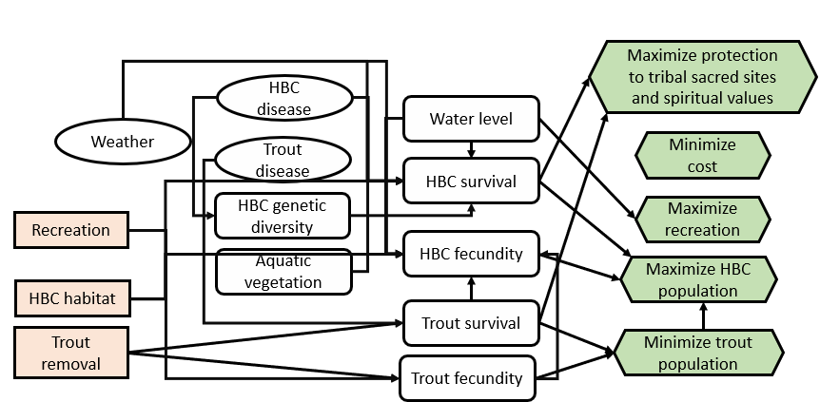
SDM project: Non-native fish control below glen canyon dam
Consequences:
Problem
framing
Influence Diagram
Articulate
Objectives
Identify
Alternatives
Predict
Consequences
Adapted, modified, and simplified from Runge et al. 2011

Slide 50
SDM project: Non-native fish control below glen canyon dam
Consequences:
Simplified consequence table (relative table for illustration)
Objective |  |  |  | Alternative
Objective | Direction | Attribute |  | A | B | C | D | E
Respect Life | Max | [0-10 scale] |  | 6 | 7 | 6 | 9.5 | 9
HBC Recovery | Max | [P(N>6000)] |  | 0.2 | 0.3 | 0.3 | 0.3 | 0.25
Wilderness Disturbance | Min | [User-days] |  | 0 | 30 | 40 | 50 | 60
Cost | Min | [M$/5-yr] |  | 0 | 2.5 | 3 | 4.5 | 2
MODEL:
Expert elicitation
Population model
Expert elicitation/ population model
Adapted, modified, and simplified from Runge et al. 2011

Slide 51
SDM project: Non-native fish control below glen canyon dam
Tradeoffs:
Problem
framing
“How much you would give up on one objective in order to achieve gains on another objective”
- Gregory et al. 2012
Decide & Implement
Articulate
Objectives
Objective
Objective | Direction | Attribute
Respect Life | Max | [0-10 scale]
HBC Recovery | Max | [P(N>6000)]
Wilderness Disturbance | Min | [User-days]
Cost | Min | [M$/5-yr]
Perform
Tradeoffs
Identify
Alternatives
Predict
Consequences
Adapted, modified, and simplified from Runge et al. 2011

Slide 52
SDM project: Non-native fish control below glen canyon dam
Tradeoffs:
“How much you would give up on one objective in order to achieve gains on another objective”
- Gregory et al. 2012
Objective Weights:
Objective
Objective | Direction | Attribute
Respect Life | Max | [0-10 scale]
HBC Recovery | Max | [P(N>6000)]
Wilderness Disturbance | Min | [User-days]
Cost | Min | [M$/5-yr]
Hypothetical for illustration
0.2
0.4
0.1
0.3
Adapted, modified, and simplified from Runge et al. 2011

Slide 53
SDM project: Non-native fish control below glen canyon dam
Tradeoffs:
Simplified consequence table (relative table for illustration)
Weights:
Objective |  |  |  | Alternative
Objective | Direction | Attribute |  | A | B | C | D | E
Respect Life | Max | [0-10 scale] |  | 6 | 7 | 6 | 9.5 | 9
HBC Recovery | Max | [P(N>6000)] |  | 0.2 | 0.3 | 0.3 | 0.3 | 0.25
Wilderness Disturbance | Min | [User-days] |  | 0 | 30 | 40 | 50 | 60
Cost | Min | [M$/5-yr] |  | 0 | 2.5 | 3 | 4.5 | 2
Hypothetical for illustration
0.2
0.4
0.1
0.3
Adapted, modified, and simplified from Runge et al. 2011

Slide 54
SDM project: Non-native fish control below glen canyon dam
Tradeoffs:
Simplified consequence table (relative table for illustration)
Rescale!
0 to 1
Weights:
Objective |  |  |  | Alternative
Objective | Direction | Attribute |  | A | B | C | D | E
Respect Life | Max | [0-10 scale] |  | 6 | 7 | 6 | 9.5 | 9
HBC Recovery | Max | [P(N>6000)] |  | 0.2 | 0.3 | 0.3 | 0.3 | 0.25
Wilderness Disturbance | Min | [User-days] |  | 0 | 30 | 40 | 50 | 60
Cost | Min | [M$/5-yr] |  | 0 | 2.5 | 3 | 4.5 | 2
Hypothetical for illustration
0.2
0.4
0.1
0.3
Adapted, modified, and simplified from Runge et al. 2011

Slide 55
SDM project: Non-native fish control below glen canyon dam
Tradeoffs:
Simplified consequence table (relative table for illustration)
Weights:
Objective |  |  |  | Alternative
Objective | Direction | Attribute |  | A | B | C | D | E
Respect Life | Max | [0-10 scale] |  | 0 | 0.29 | 0 | 0.86 | 1
HBC Recovery | Max | [P(N>6000)] |  | 0 | 1 | 1 | 1 | 0.5
Wilderness Disturbance | Min | [User-days] |  | 1 | 0.5 | 0.33 | 0.17 | 0
Cost | Min | [M$/5-yr] |  | 1 | 0.44 | 0.33 | 0 | 0.56
Hypothetical for illustration
0.2
0.4
0.1
0.3
Adapted, modified, and simplified from Runge et al. 2011

Slide 56
SDM project: Non-native fish control below glen canyon dam
Tradeoffs:
Simplified consequence table (relative table for illustration)
Weights:
Objective |  |  |  | Alternative
Objective | Direction | Attribute |  | A | B | C | D | E
Respect Life | Max | [0-10 scale] |  | 0 | 0.29 | 0 | 0.86 | 1
HBC Recovery | Max | [P(N>6000)] |  | 0 | 1 | 1 | 1 | 0.5
Wilderness Disturbance | Min | [User-days] |  | 1 | 0.5 | 0.33 | 0.17 | 0
Cost | Min | [M$/5-yr] |  | 1 | 0.44 | 0.33 | 0 | 0.56
Weighted outcome: (sum product of weight and outcome) |  |  |  | 0.4 | 0.64 | 0.53 | 0.59 | 0.57
Hypothetical for illustration
0.2
0.4
0.1
0.3
Adapted, modified, and simplified from Runge et al. 2011

Slide 57
SDM project: Non-native fish control below glen canyon dam
Problem
framing
Decision/ adaptive management approach:
Decide & Implement
Articulate
Objectives
“A value of information analysis pointed to an adaptive strategy that contemplates three possible long-term management actions”
No action
Lower Colorado River Removal
Paria to Badger Reach Removal
Monitor, learn, & update models
Perform
Tradeoffs
Identify
Alternatives
Predict
Consequences
Adapted, modified, and simplified from Runge et al. 2011

Slide 58

Skills check (15 minutes)
Divide into 4-5 groups
I will hand out a scenario examples to each group
Each group will identify:
The bias(es) present
How the bias could affect decision outcomes
How SDM principles (e.g., PrOACT, problem decomposition) could improve the decision
1 minute presentation to the class
Developed by Brielle Thompson

Slide 59

Group 1:
A wildlife agency has spent $2 million developing a corridor to connect fragmented habitats. Early monitoring shows minimal animal movement through the corridor. Despite this, the agency continues investing in signage, fencing, and outreach.
Developed by Brielle Thompson

Slide 60

Group 2:
After watching a documentary on coral bleaching, a coastal conservation group shifts all funding to reef restoration, even though local data shows mangrove degradation is a more pressing issue.
Developed by Brielle Thompson

Slide 61

Group 3:
A regional water authority is considering expanding a reservoir to increase water storage capacity. The expansion was proposed 10 years ago, and millions have already been spent on feasibility studies and land acquisition. However, recent climate models suggest that rainfall patterns are shifting, and the reservoir may not fill as expected. Despite this, the authority continues to push forward with the expansion.
Developed by Brielle Thompson

Slide 62

Group 4:
A state agency has been monitoring a native minnow species for over a decade using a fixed set of sampling sites and methods. Recent studies suggest that the species has shifted its range due to changing stream temperatures and flow patterns. However, the agency continues using the same monitoring protocol, arguing that consistency is key for long-term data.
Developed by Brielle Thompson

Slide 63

Group 5:
A conservation district has used the same fertilizer blend for over 15 years to support native grass restoration on degraded soils. Recent soil tests show increased salinity and reduced microbial activity, suggesting the blend may be contributing to long-term soil degradation. Despite this, the district continues using the same formula, citing past success and ease of procurement.
Developed by Brielle Thompson

Slide 64

Discussion:
What makes a good decision?

Slide 65
Looking ahead:
Next week: Pr step of PrOACT
Weekly: Work through a step of the PrOACT process/ learn extra tools
Last week of class:
Elevator pitch of your research project in terms of SDM/PrOACT
Note: Abridged PrOACT story slides with a star on the upper right are good examples to use for your presentation

Slide 66

Extra time activities:

Slide 67
Good decision making -Activity
Think about the last time you made a big decision, or a future decision you are worried about (personal or research)
What was the decision?
What were the desired outcomes of your decision?
What did you care about? What did you want out of the decision?
Did you have any alternatives you were considering?
How did you make your decision?
What made the decision challenging?

Slide 68
Good decision making –Activity 2
Individually write down qualities that you think make a good decision
Then, in groups compare your lists
Then, we will come together to discuss what makes a good decision

Slide 69
System 1 vs System 2- Activity
Write your immediate reaction to the following scenarios:
A lake is suddenly overrun with invasive snails
A farming region experiences a severe drought
A wetland manager notices a sudden die-off of native frogs
After a nearby wildfire, a community demands immediate action
A forest reserve reports a sharp decline in its native owl population over the past two years
With a partner discuss how your system 2 brain might respond to the scenarios

Slide 70
Reading discussion:
Discuss Gregory and Long 2012 Chapter 1:
What distinguishes Structured Decision Making (SDM) from traditional environmental decision-making approaches such as science-based, consensus-based, or economic analysis?
In what ways can SDM help build trust and collaboration among stakeholders with conflicting interests?
The chapter emphasizes the importance of developing creative alternatives. Why is this step often overlooked in conventional decision-making, and how does SDM encourage innovation?
What are some potential limitations or challenges of implementing SDM in real-world environmental management scenarios?
The authors describe SDM as both a science and an art. What does this mean?

